Slide 1
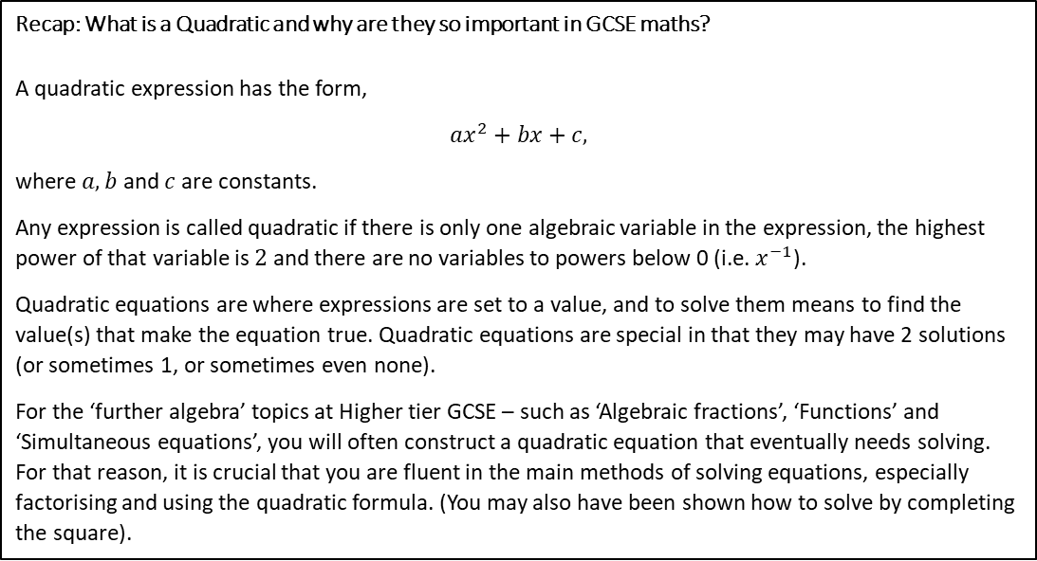







Subtopic 2 – Recap: Solving Quadratic Equations
LEARNING OUTCOME: Recap the core skill of solving quadratics.
Objectives:
To recap the three main methods of solving quadratics:
Factorise
Use the quadratic formula
Complete the square
Recap: What is a Quadratic and why are they so important in GCSE maths?
A quadratic expression has the form,
$$ax^{2}+bx+c,$$
where $a, b$ and $c$ are constants.
Any expression is called quadratic if there is only one algebraic variable in the expression, the highest power of that variable is $2$ and there are no variables to powers below 0 (i.e. $x^{−1}$).
Quadratic equations are where expressions are set to a value, and to solve them means to find the value(s) that make the equation true. Quadratic equations are special in that they may have 2 solutions (or sometimes 1, or sometimes even none).
For the ‘further algebra’ topics at Higher tier GCSE – such as ‘Algebraic fractions’, ‘Functions’ and ‘Simultaneous equations’, you will often construct a quadratic equation that eventually needs solving. For that reason, it is crucial that you are fluent in the main methods of solving equations, especially factorising and using the quadratic formula. (You may also have been shown how to solve by completing the square).
PRIOR KNOWLEDGE QUIZ
1. Solve each equation by factorising first.
You will have to check the equation is in the form $x^{2}+bx+c=0$
a.$x^{2}+4x+4=0$
b. $x^{2}+5x+6=0$
c. $x^{2}+10x+24=0$
d. $x^{2}+20=9x$
e. $x^{2}=12x −20$
f. $15=8x{−x}^{2}$
1

Slide 2









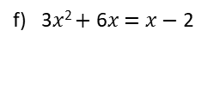

PRIOR KNOWLEDGE QUIZ (CONT.)
2. Solve each equation, by factorising first.
You will have to check the equation is in the form ${ax}^{2}+bx+c=0$
a) 2$x$² $+$ 3$x$ $−$ 35 $=$ 0
b) 4$x$² $−$ 3$x$ $−$ 22 $=$ 0
c) 3$x$² $+$ 4$x$ $−$ 4 $=$ 0
d) 2$x$² $=$ 3$x$ $+$ 5
e) 2$x$² $+$ 1 $=$ 3$x$
f) 3$x$² $+$ 6$x$ $=$ $x$ $−$ 2
3. Solve each equation using the quadratic formula.
You will have to check the equation is in the form ${ax}^{2}+bx+c=0$
$x^{2}+6x+3=0$
b) $2x^{2}+7x+1=0$
c$) x^{2}−7x+1=0$
2

Slide 3
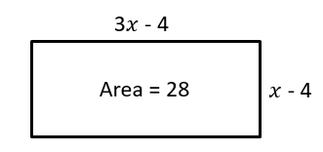
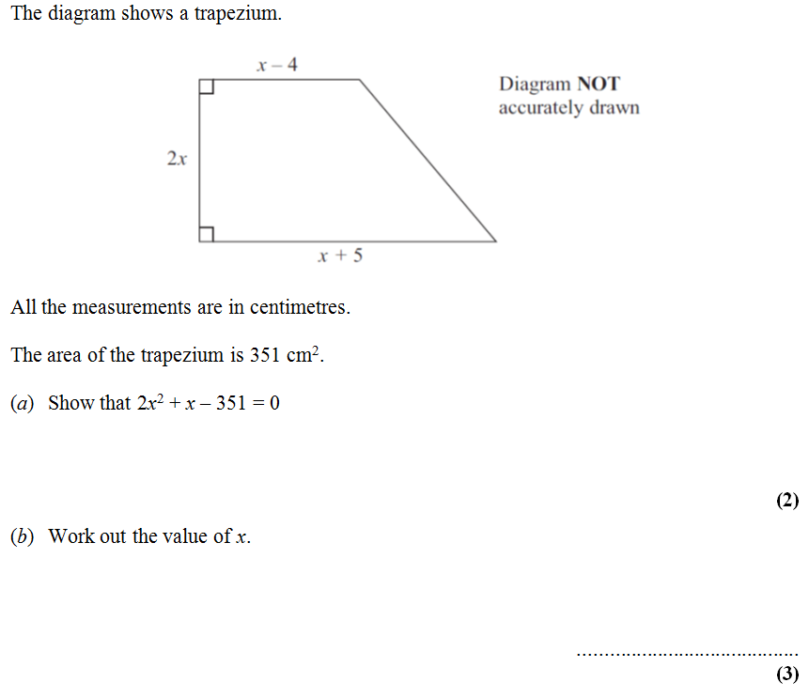
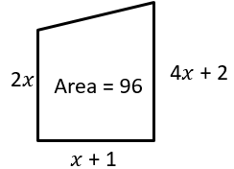



PRIOR KNOWLEDGE QUIZ (CONT.)
Determine the value of $x$:
c) Determine the value of $x$
Solve $\frac{5{\left(2x+1\right)}^{2}}{4x+5}=5x−1$

Slide 4
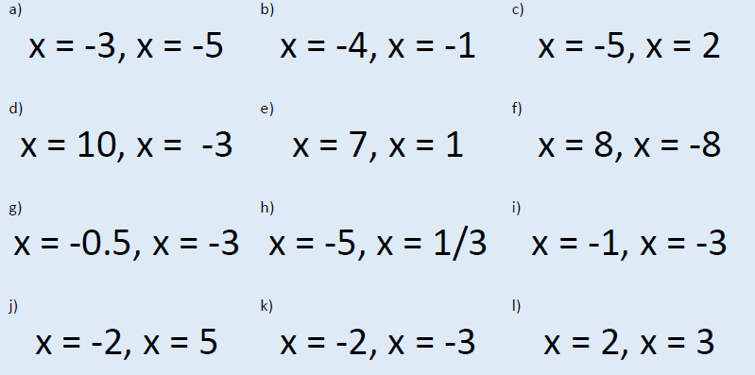
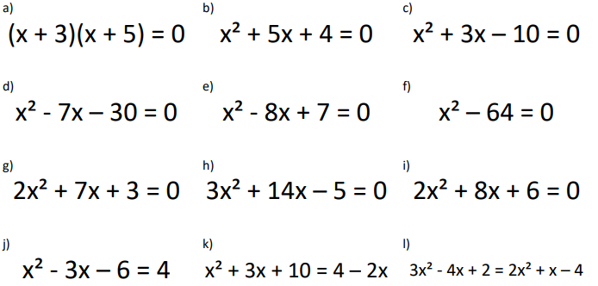
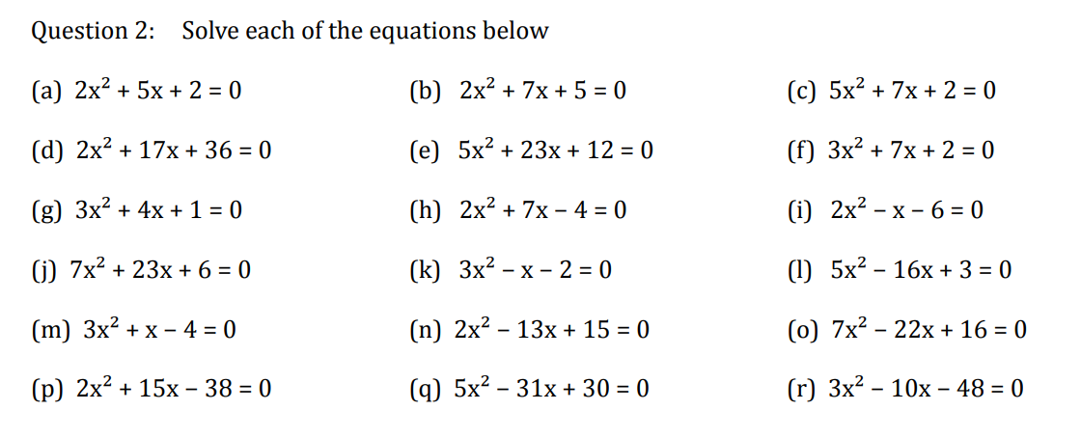
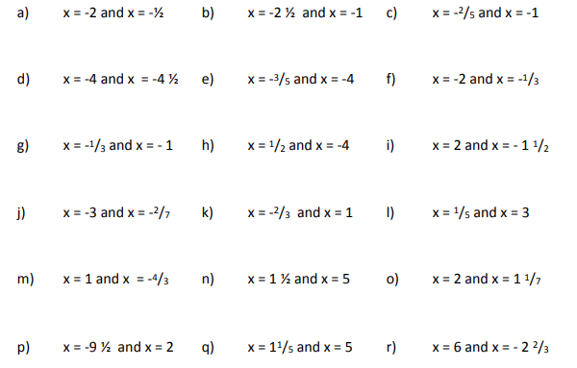
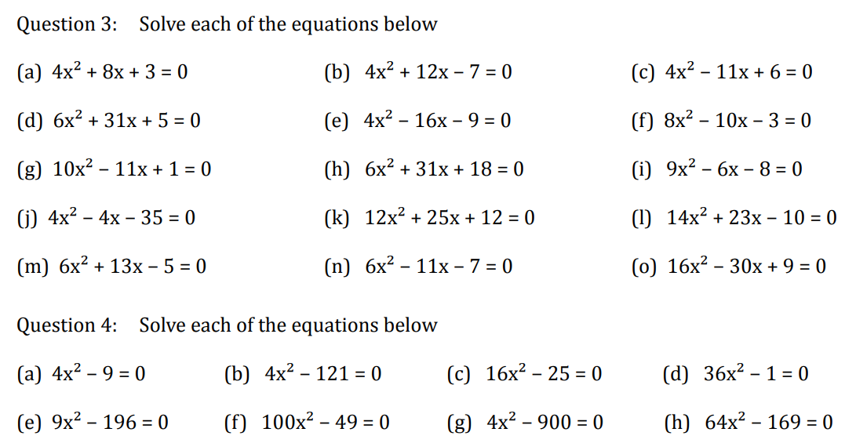
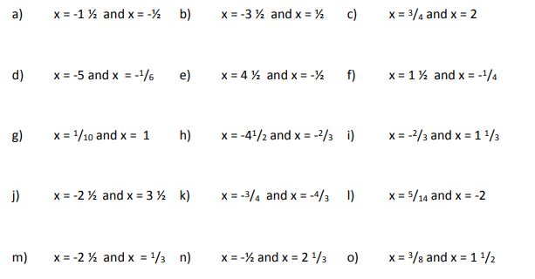

MIXED PRACTICE (SLOP)
Question 1: Solve these increasingly difficult quadratic equations:

Slide 5
